Slide 1
Title:- ONLINE BOOKSTORE CATEGORY MANAGEMENT SYSTEM

Slide 2
Problem Statement:-
Managing categories in an online bookstore becomes complex when there are multiple levels of categories and subcategories.
This project provides a system to organize and manage categories using a tree structure efficiently.

Slide 3
Real-world Application:-
Used in e-commerce websites (Amazon, Flipkart)
Helps users navigate products easily
Organizes books into categories like Fiction, Science, History
Improves search and browsing experience

Slide 4
Data Structure Used:-
General Tree Data Structure Each node contains:
Category name
List of child categories
Number of children

Slide 5
System Design:-
Menu-driven CLI (Command Line Interface)
Tree structure for category storage
Dynamic updates using user input
Recursive traversal for operations

Slide 6
Algorithm:-
Start program
Display menu
Get user choice
Operate (Add/Search/Delete/Update)
Repeat until Exit

Slide 7
Implementation:-
Language: C
Concepts used:
Structures
Pointers
Recursion
Dynamic Memory Allocation

Slide 8
Features:-
Add new categories
Display category tree
Search categories
Update category name
Delete category with subcategories
Fast operations using recursion

Slide 9
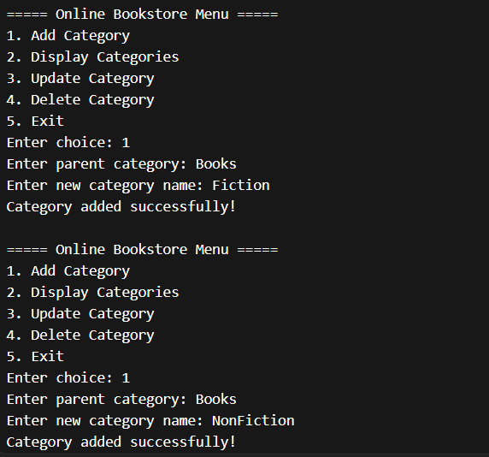
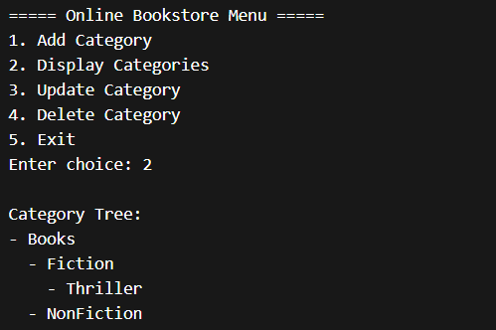
Demo Output:-

Slide 10
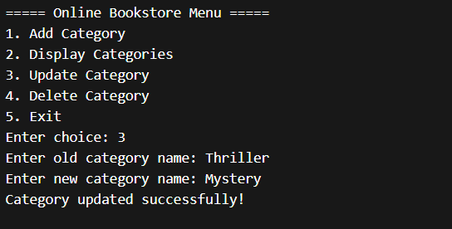
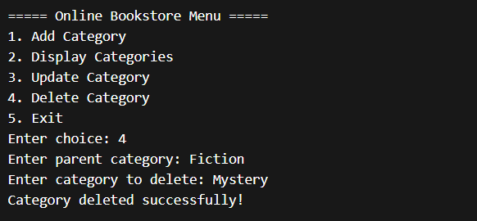

Slide 11
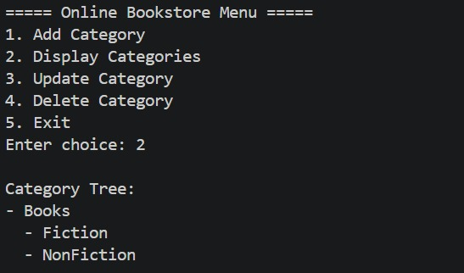
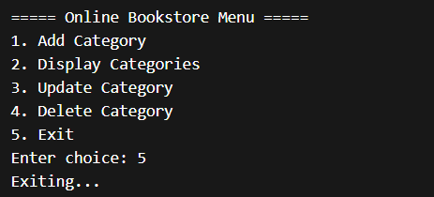

Slide 12
Conclusion:-
Efficient way to manage hierarchical data
Demonstrates a tree data structure in C
Useful for learning Data Structures and Algorithms

Slide 13
Limitations:-
Maximum 10 subcategories
No file storage
Category names without spaces

Slide 14
Future Improvements:-
Add file handling (save data)
Case-insensitive search
Unlimited subcategories
GUI-based application

Slide 15
Thank You

